Slide 1
Predicting Solar Energy Production
Project Presented by Sanu Mathew

Slide 2
Table of Contents
Problem statement
data understanding
Data Cleaning & Preprocessing
Feature Engineering
Exploratory Data Analysis (EDA)
Model Selection
Training & Validation
Hyperparameter Tuning
Model Evaluation
Conclusion with business insights
Recommendations for future work

Slide 3
Problem Statement:Solar Energy Generation Prediction
With the global shift toward renewable energy, solar power has emerged as a key sustainable solution. However, one of the major challenges in solar energy adoption is the uncertainty in energy generation due to its dependence on dynamic environmental and operational factors.
Solar energy output is influenced by multiple variables such as:
Solar irradiance
Temperature and weather conditions
Geographic location
Seasonal variations
Panel efficiency and installation factors
Because of this variability, accurately predicting solar energy generation becomes difficult using traditional estimation methods.

Slide 4
Problem
Currently, solar energy production is often estimated using:
Historical averages
Static models
Generic assumptions
These approaches fail to capture real-world variability, leading to:
Inaccurate energy forecasts
Poor planning and scheduling
Suboptimal system design
Financial uncertainty in ROI calculations
Inefficient energy distribution and grid management

Slide 5
The objective of this project is to develop a machine learning-based predictive model that can accurately estimate solar energy generation based on historical and environmental data.
The system will:
Analyze patterns in solar production data
Learn relationships between weather, time, and energy output
Provide reliable predictions for future energy generation
Key Challenges
Data Quality Issues
Missing values, noise, and inconsistencies in real-world datasets
Non-Linear Relationships
Complex interactions between irradiance, temperature, and output
Temporal Dependency
Seasonal and daily variations significantly impact production
Feature Engineering Complexity
Need for domain-specific features like efficiency and lag variables

Slide 6
Proposed Approach
To address these challenges, the project will implement a machine learning pipeline consisting of:
Data Cleaning & Preprocessing Handling missing values, outliers, and inconsistencies
Exploratory Data Analysis (EDA) Identifying trends, correlations, and seasonal patterns
Feature Engineering Creating meaningful features such as:
Time-based features (month, seasonality)
Solar efficiency indicators
Lag and rolling features
Model Development Training regression models like Random Forest and XGBoost
Evaluation Measuring performance using MAE and RMSE
Expected Outcome
The developed model will:
Provide accurate solar energy predictions
Improve planning and decision-making
Help optimize system design and installation
Reduce financial risks and uncertainty

Slide 7
Dataset Understanding
Overview
The dataset used in this project contains detailed records of solar photovoltaic (PV) installations, including system specifications, geographic information, utility data, and estimated energy production. Each row represents an individual solar project or installation, providing insights into factors that influence solar energy generation.
The dataset consists of 188,452 records, making it a large-scale, real-world dataset suitable for building robust machine learning models for solar energy prediction.
Dataset Structure
Total Records: 188,452
Total Features: 17
Data Types:
Numerical: System sizes, energy production
Categorical: Utility, developer, location
Date: Installation and reporting dates

Slide 8
Feature Description
1. Temporal Features
Data Through Date Indicates the last update or reporting date of the dataset
Interconnection Date Represents the date when the solar system was connected to the grid
These features help capture time-based trends and adoption patterns.
2. Project Identification
Project ID Unique identifier for each solar installation
Number of Projects Indicates grouped or aggregated project counts
3. Utility & Grid Information
Utility Name of the electricity provider
Division (partially missing) Subdivision of the utility
Substation (partially missing) Grid connection point
Circuit ID Identifier for the electrical circuit
Metering Method Type of metering used (e.g., net metering)
These features provide insights into grid infrastructure and operational setup.

Slide 9
4. Location-Based Features
City/Town, County, Zipcode -These features help capture geographical variation, which is crucial for solar energy prediction due to differences in sunlight exposure and climate.
5. Developer Information
Indicates the company responsible for installation-This feature can reflect quality, efficiency, and installation practices.
6. System Specifications
Estimated PV System Size (kWdc) & PV System Size (kWac)-These are critical features as they directly influence energy production.
7. Energy Output (Target Variable)
Estimated Annual PV Energy Production (kWh)-Represents the expected yearly energy generation
This is the target variable used for prediction in the machine learning model.
8. Energy Storage Feature Energy Storage System Size (kWac)-Indicates battery/storage capacity where available

Slide 10
Data Quality Observations:
Missing Values Present In:
Division
Substation
Developer
City/Town
Zip Code
Energy Storage System Size (majority missing)
High Sparsity:
Energy storage data is available for only a small subset (~3,500 records)
Data Type Issues:
Date columns stored as objects need conversion to datetime

Slide 11
Data Cleaning & Preprocessing:
The data cleaning and preprocessing phase plays a critical role in ensuring that the dataset is accurate, consistent, and suitable for machine learning modeling. Given the large size of the dataset (188K+ records) and the presence of missing values, categorical inconsistencies, and date fields, a structured preprocessing pipeline was implemented.
Before applying transformations, the dataset was analyzed to identify:
Missing values across multiple columns
Duplicate records
Incorrect data types (especially date fields)
Sparse features with limited usability
Data Cleaning Steps done in this project:
1. Handling Missing Values
The dataset contained missing values in several columns such as: Division, Substation, Developer, City/Town, Zip Code, Energy Storage System Size

Slide 12
Categorical features (e.g., Developer, City/Town): Filled using mode or labeled as "Unknown“
Numerical features (e.g., Zip, storage size):Filled using median values
Highly sparse column (Energy Storage System Size):Evaluated for relevance; either imputed cautiously or excluded due to excessive missing data
2. Removing Duplicates
Duplicate records were identified and removed to avoid bias and over-representation in model training.
3. Standardizing Categorical Variables
Categorical columns such as: Utility, Developer & City/Town were cleaned by
Converting text to lowercase, Removing leading/trailing spaces & Ensuring consistent naming
4. Date Conversion & Feature Extraction
Data Through Date & Interconnection Date were converted from object type to datetime format.
From these, new features were derived: Year, Month, Day & Day of Week These features help capture temporal patterns in solar adoption and energy trends.

Slide 13
5. Outlier Detection & Handling
Outliers were analyzed using statistical techniques such as the Interquartile Range (IQR) method.
Extreme values in system size and energy production were reviewed
Only unrealistic or erroneous outliers were removed
Legitimate high-production values were retained to preserve real-world behavior
6. Feature Encoding
Categorical variables were transformed into numerical format using:
One-Hot Encoding for nominal categories
Label encoding where appropriate
7. Feature Scaling
Numerical features such as: PV system size (kWdc/kWac) & Energy-related variableswere standardized using scaling techniques to improve model performance
8. Feature Selection / Dropping Irrelevant Columns
Certain columns were removed due to:High missing values, Low predictive importance & Redundancy like Project ID (identifier, no predictive value)

Slide 14
Feature Engineering
Feature engineering was applied to transform raw solar installation data into more informative and model-friendly features. The focus was on capturing system efficiency, temporal patterns, data normalization, and reducing noise/complexity to improve predictive performance.
1. Energy Efficiency Feature
Feature Created: energy_per_kw = annual_energy / capacity_kw
Raw energy (annual_energy) scales with system size (capacity_kw). Larger systems naturally produce more energy, which can bias the model. By normalizing energy with capacity, we measure efficiency rather than scale.
2. Temporal Features from Interconnection Date
Features Created:
year = Interconnection Date.year captures long-term trends and adoption growth
month = Interconnection Date.month captures seasonality effects (e.g., higher production in summer)
3. Outlier Handling Using IQR (on Efficiency)
energy_per_kw - Extreme values in efficiency may indicate: Data entry errors or unusual system behaviour

Slide 15
Method:
Calculated:
Q1 (25th percentile)
Q3 (75th percentile)
IQR = Q3 − Q1
Defined bounds:
Lower = Q1 − 1.5 × IQR
Upper = Q3 + 1.5 × IQR
Removed values outside this range
Eliminates noise and unrealistic values, Improves model stability and generalization & Ensures learning from valid system performance patterns
4. Log Transformation of Target Variable
log_energy = log1p(annual_energy) Energy data is typically right-skewed (many small systems, few very large ones), Log transformation reduces skewness and compresses extreme values. Makes distribution more normal-like. Improves model performance for regression algorithms
5. Reducing Cardinality in Developer Feature
The developer column contains many unique categories, Kept top 50 most frequent developers & Grouped remaining into "other"

Slide 16
Exploratory Data Analysis
Exploratory Data Analysis (EDA) was conducted to understand the structure, patterns, and relationships within the solar energy dataset. This step is essential for identifying data quality issues, feature distributions, correlations, and underlying trends before building machine learning models
EDA guided key decisions in data cleaning, preprocessing, and feature engineering.
Objectives of EDA
Understand dataset structure and feature types
Identify missing values and inconsistencies
Analyze distribution of key variables
Detect outliers and anomalies
Explore relationships between features and target variable
Uncover temporal and geographical patterns
1. Dataset Overview
Total records: 188,000+ observations, Mix of numerical, categorical, and date features. Target variable: Estimated Annual PV Energy Production (kWh)

Slide 17
Initial checks included: Data types and structure, Missing value analysis & Duplicate detection
2. Target Variable Analysis
The target variable (annual energy production) showed a right-skewed distribution.
Majority of installations produced moderate energy, while a few large systems produced significantly higher values.
Log transformation (log_energy) was applied to normalize the distribution and improve model performance
3. Feature Distribution Analysis
Numerical Features: PV system size (kWdc/kWac) showed wide variation. Strong positive trend observed between system size and energy output
Categorical Features: High cardinality in features like developer and utility, Some categories dominated the dataset
Cardinality reduction (top developers) was applied, One-hot encoding used for categorical variables
4. Correlation Analysis
Strong positive correlation between: System size (kWac/kWdc) and energy production. This led to creation of efficiency feature (energy_per_kw)
Moderate relationships observed with: Location-based features & Utility and developer

Slide 18
5. Outlier Detection
Outliers detected in: Energy production & Efficiency (energy_per_kw). Extreme values identified using IQR method. Outliers removed to reduce noise
6. Temporal Analysis
Analysis based on Interconnection Date revealed Growth in solar installations over years & Seasonal patterns in energy generation. Extracted year and month features which improves model understanding.
7. Geographical Analysis
Variation observed across: Cities, Counties & Zip codes. Location-based features contribute to prediction
8. Missing Value Analysis
Missing values found in: Developer, Division, Substation & Zip code
Imputation strategies applied & Highly sparse columns evaluated for removal

Slide 19
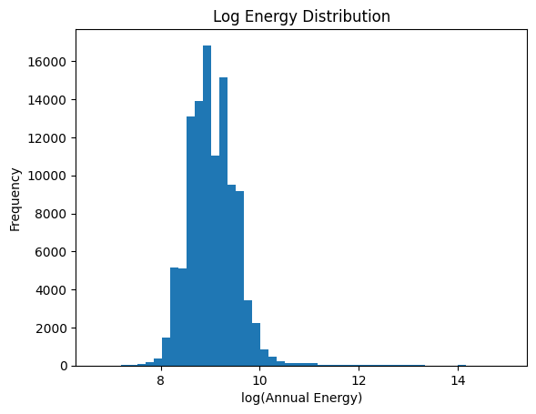
Log Energy Distribution
The histogram shows the distribution of the log-transformed annual energy production (log_energy).
After applying the log transformation, the data appears approximately normally distributed, with most values concentrated between 8 and 10.
The transformation has successfully reduced right skewness present in the original energy values.
Extreme high values (outliers) are still visible but are compressed, reducing their impact on the model.
Log transformation makes the target variable more stable and model-friendly, improving the performance of regression algorithms by:
Reducing variance
Minimizing the influence of extreme values
Bringing the distribution closer to normal
The log transformation effectively normalized the energy distribution, making it suitable for accurate and stable machine learning predictions

Slide 20
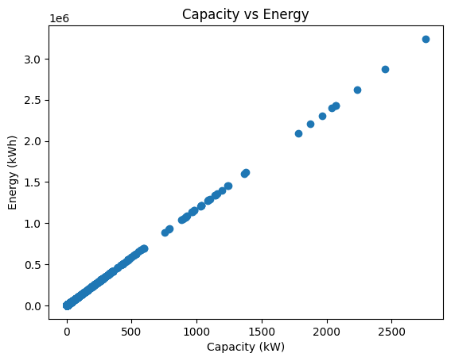
Capacity vs Energy
The scatter plot shows the relationship between system capacity (kW) and annual energy production (kWh).
There is a strong positive linear relationship between capacity and energy output.
As system capacity increases, energy production increases proportionally.
The points are closely aligned along a straight line, indicating very high correlation and minimal noise.
Capacity is the most dominant predictor of energy generation.
This confirms that larger solar systems produce more energy in a consistent and predictable manner.
Solar energy production scales almost linearly with system capacity, making it a key feature for accurate prediction models.

Slide 21
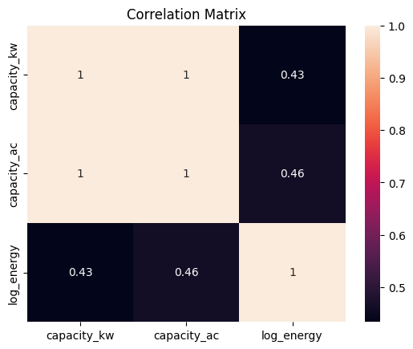
Correlation Matrix
The heatmap shows the correlation between capacity (kW, kWac) and log-transformed energy (log_energy).
capacity_kw and capacity_ac have a perfect correlation (~1.0), indicating they carry almost identical information.
Both capacity features show a moderate positive correlation with log_energy (~0.43–0.46).
The perfect correlation between capacity_kw and capacity_ac indicates multicollinearity → one of them can be removed to avoid redundancy.
Capacity is still an important predictor, but after log transformation, its relationship with energy appears less extreme and more stable.
Capacity remains a key driver of energy output, but redundant features should be removed to improve model efficiency and reduce multicollinearity

Slide 22
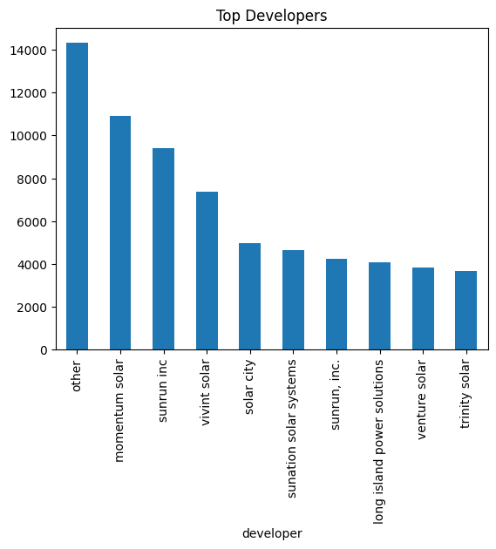
Top Developers
The bar chart shows the distribution of solar installations across different developers.
The “other” category dominates, indicating that many developers have relatively small individual contributions.
A few developers such as Momentum Solar, Sunrun Inc, and Vivint Solar have significantly higher project counts compared to others.
The distribution is highly skewed, with a long tail of less frequent developers.
The developer feature has high cardinality, which can increase model complexity
Grouping less frequent developers into an “other” category is justified and helps reduce noise.
Top developers may capture installation quality or operational efficiency patterns.
The developer distribution is skewed with a few dominant players, making cardinality reduction essential for efficient and stable modeling

Slide 23
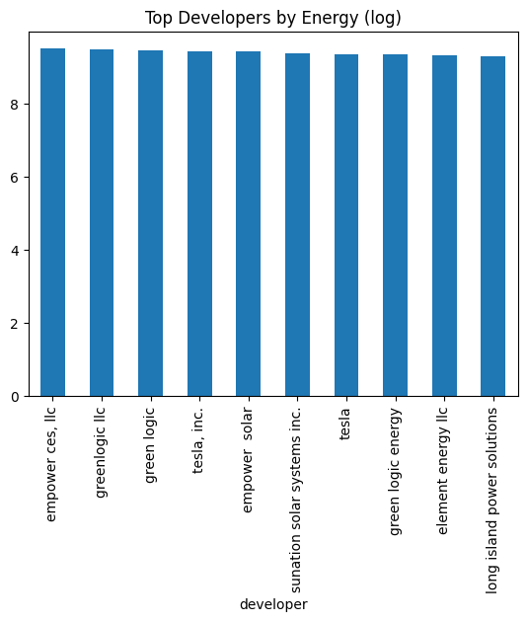
Top Developers by Energy(Log)
The bar chart shows the average log-transformed energy production across top developers.
All developers exhibit very similar log energy values, with only minor differences between them.
No single developer significantly outperforms others in terms of energy efficiency after normalization.
Developer impact on energy output appears limited compared to system capacity.
The similarity suggests that energy production is more influenced by system size and external factors rather than the developer alone.
This also validates grouping smaller developers into an “other” category without major loss of information.
Energy production is relatively consistent across developers, indicating that developer choice has a smaller impact compared to core factors like system capacity.

Slide 24
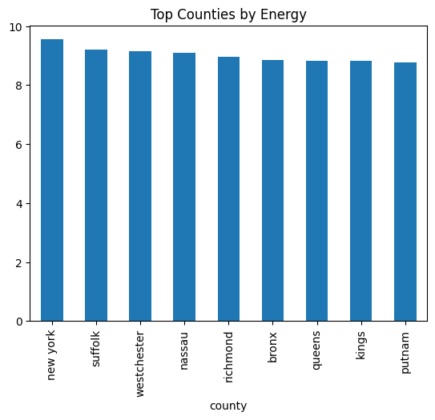
Top Counties By Energy
The chart shows the average log-transformed energy production across different counties.
Energy values across counties are fairly similar, with only slight variations.
New York County shows the highest average energy, followed closely by Suffolk and Westchester.
Other counties like Queens, Kings, and Putnam exhibit slightly lower but comparable values.
Geographic location (county) has some influence, but differences are not very large.
This suggests that while location matters, it is not the primary driver of energy output.
Core factors like system capacity and efficiency likely have a stronger impact.
Energy production shows minor variation across counties, indicating that location has a moderate but not dominant effect on solar energy output

Slide 25
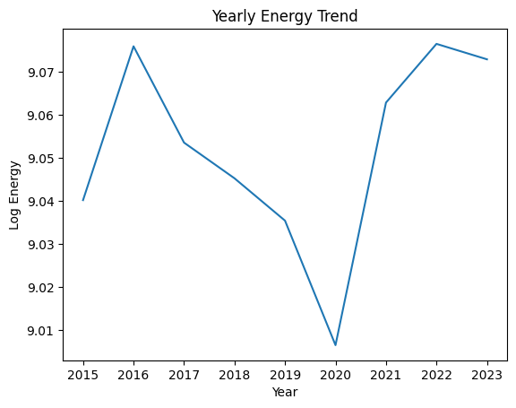
Yearly Energy Trend
The line chart shows the trend of log-transformed annual energy production over time (2015–2023).
Energy production shows a slight fluctuation over the years rather than a strong upward or downward trend.
There is a noticeable dip around 2020, followed by a recovery and increase in subsequent years.
Post-2020, energy levels stabilize and slightly improve, peaking around 2022.
The dip in 2020 may reflect external factors (e.g., operational disruptions or data variation).
Overall, energy production remains relatively stable over time.
Year alone is not a strong predictor but helps capture temporal variations and trends.
Solar energy production shows minor year-to-year variation with a temporary dip around 2020, indicating stable long-term performance with slight temporal fluctuations.

Slide 26
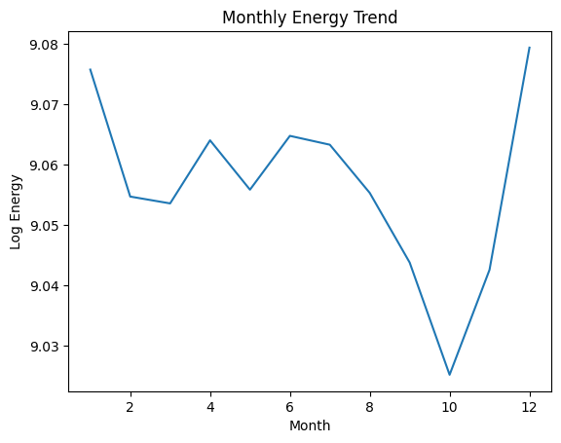
Monthly Energy Trend
The line chart shows the variation of log-transformed energy production across months.
Energy production is relatively stable for most months, with moderate fluctuations.
A noticeable dip occurs around September–October, indicating lower energy output during this period.
Energy rises again towards the end of the year, with December showing the highest value.
The pattern reflects seasonal variation in solar energy production.
Lower values in late months may be due to reduced sunlight or weather conditions.
Monthly trends confirm the importance of including seasonal features in the model.
Solar energy production varies across months with a seasonal pattern, making month-based features important for accurate prediction.

Slide 27
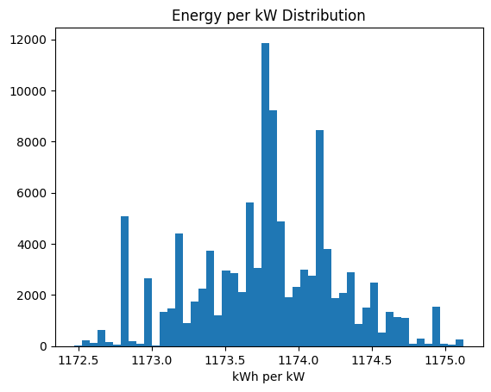
Energy per kW Distribution
The histogram shows the distribution of energy generated per unit capacity (kWh per kW), which represents system efficiency.
The values are tightly clustered around a narrow range (~1173–1174 kWh/kW).
The distribution appears approximately normal, with very low spread.
Only a few minor deviations (outliers) are present.
Solar systems in the dataset have highly consistent efficiency across installations.
This indicates standardized performance, likely due to similar environmental conditions and system quality.
The low variance suggests that capacity drives energy more than efficiency differences.
Energy per kW is highly consistent across systems, indicating stable efficiency and reinforcing capacity as the primary driver of energy output.

Slide 28
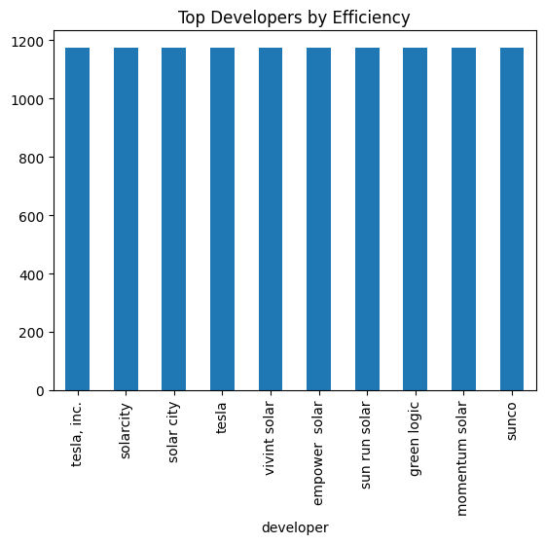
Top Developers by Efficiency
The chart compares average energy per kW (efficiency) across top developers.
Efficiency values are nearly identical across all developers, clustered tightly around ~1175–1180 kWh/kW.
No developer shows a significant advantage or disadvantage in performance.
Developer impact on system efficiency is minimal.
Solar systems appear to operate with consistent performance standards regardless of installer.
This reinforces that capacity and external conditions play a bigger role than developer differences.
Solar system efficiency is consistent across developers, indicating that developer choice has limited influence on performance compared to core system and environmental factors

Slide 29
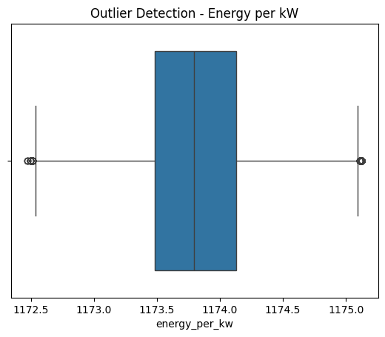
Outlier Detection – Energy per kW
The boxplot visualizes the distribution of energy per kW (system efficiency) and highlights potential outliers.
The data is tightly concentrated, with most values lying within a narrow range.
A few points appear outside the whiskers, indicating minor outliers on both lower and higher ends.
The median lies near the center of the box, suggesting a balanced distribution.
The small spread confirms high consistency in system efficiency across installations.
Detected outliers are minimal and likely represent slight deviations rather than major errors.
Overall, the dataset shows stable and reliable efficiency values.
Energy per kW shows low variability with only minor outliers, indicating consistent solar system performance across the dataset.

Slide 30
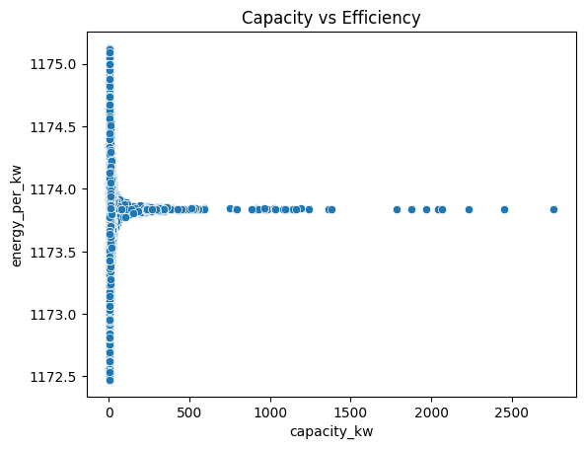
Capacity Vs Efficiency
The scatter plot shows the relationship between system capacity (kW) and energy per kW (efficiency).
Efficiency values are highly concentrated within a narrow range, regardless of system size.
There is no strong relationship between capacity and efficiency.
Smaller systems show slightly more spread, while larger systems are tightly clustered.
System efficiency remains consistent across different capacity levels.
Increasing capacity increases total energy output, but does not significantly affect efficiency.
Variations in efficiency are minimal and likely due to minor operational or environmental differences.
System capacity does not significantly influence efficiency, indicating that solar installations perform consistently across different sizes

Slide 31
Features & Target & Train-Test Split
In this step, the dataset was prepared for modeling by clearly defining the target variable, input features, and preprocessing pipeline.
The target variable was set as log_energy, which is the log-transformed version of annual energy. This helps reduce skewness and improves model stability.
The original annual_energy was reconstructed using exponential transformation for consistency, and energy_per_kw was recalculated as an efficiency feature (though not used as the target).
Features Used
The model includes a mix of:
Categorical features: developer, county, city, utility, metering method
Numerical features: capacity_kw, year, month
These features capture system size, location, operational setup, and temporal patterns.
Preprocessing Pipeline
Numerical features were standardized using StandardScaler
Categorical features were encoded using OneHotEncoder
A ColumnTransformer was used to apply transformations efficiently
Train-Test Split
Data was split into:
80% training set
20% testing set
random_state=42 ensures reproducibility

Slide 32
Model Selection
Multiple regression models were selected to compare performance and identify the best approach for solar energy prediction. The selection includes both simple baseline models and advanced ensemble methods to capture linear as well as non-linear relationships.
Models Used
Linear Regression
Used as a baseline model
Helps understand if relationships are mostly linear
Random Forest Regressor
Captures non-linear patterns using multiple decision trees
Reduces overfitting through averaging
Gradient Boosting Regressor
Builds models sequentially to correct previous errors
Effective for complex relationships
XGBoost Regressor
Advanced boosting algorithm with high performance and efficiency
Handles large datasets and feature interactions well

Slide 33
Parameter Logic:
Random Forest
n_estimators=100 → Sufficient number of trees for stable predictions without excessive training time
max_depth=10 → Controls tree complexity to prevent overfitting
random_state=42 → Consistent results across runs
Gradient Boosting
Default parameters used for simplicity and baseline comparison
random_state=42 → Consistent results across runs
XGBoost
n_estimators=200 → More boosting rounds for better learning
learning_rate=0.1 → Balanced step size for stable convergence
max_depth=6 → Prevents overly complex trees while capturing patterns
random_state=42 → Consistent results across runs
Model Selection Strategy
Start with Linear Regression to establish a baseline
Use tree-based models (Random Forest, Gradient Boosting) to capture non-linear relationships
Use XGBoost as the final high-performance model

Slide 34
Model Training & Validation
In this step, multiple models were trained and evaluated using a pipeline-based approach with cross-validation to ensure reliable and unbiased performance comparison.
Training Approach
Each model was combined with the preprocessing steps using a Pipeline:
Data preprocessing (scaling + encoding)
Model training
This ensures that data transformations are consistently applied during both training and validation.
Validation Method
5-Fold Cross-Validation (cv=5) was used:
The training data was split into 5 subsets
Each model was trained on 4 folds and validated on 1 fold
This process was repeated 5 times
Helps in:
Reducing overfitting
Providing a more robust estimate of model performance

Slide 35
Evaluation Metric
Mean Absolute Error (MAE) was used as the evaluation metric
Since cross_val_score returns negative values, the scores were converted to positive
MAE represents the average prediction error, making it easy to interpret
Models were trained using pipelines and evaluated with 5-fold cross-validation using MAE, ensuring consistent preprocessing and reliable performance comparison across models

Slide 36
Model Comparison
After training and cross-validation, the performance of all models was compiled into a dataframe (results_df) containing Model names and their corresponding MAE (Mean Absolute Error).
The model performance comparison based on Mean Absolute Error (MAE) shows clear differences in predictive accuracy:
Random Forest achieved the lowest MAE (0.000054), making it the best-performing model.
Gradient Boosting (0.001508) and XGBoost (0.001890) also performed well, but slightly worse than Random Forest.
Linear Regression (0.084142) showed significantly higher error, indicating poor performance.
Random Forest outperformed all models, suggesting that the dataset benefits from non-linear modeling and ensemble learning.
Boosting models (Gradient Boosting, XGBoost) performed strongly but did not surpass Random Forest, possibly due to parameter settings or data characteristics.
Linear Regression underperformed, indicating that relationships in the data are not purely linear.
Random Forest emerged as the best model with the lowest error, highlighting the importance of ensemble methods for capturing complex patterns in solar energy data, while linear models proved insufficient for this problem

Slide 37
Hyperparameter Tuning
Hyperparameter tuning was performed on the Random Forest model to improve its performance by finding the optimal combination of parameters.
A Pipeline was created to combine preprocessing and the Random Forest model
RandomizedSearchCV was used instead of Grid Search for faster and efficient exploration of parameter space
Parameters Tuned
n_estimators (100, 200, 300) → Controls the number of trees; more trees improve stability but increase computation
max_depth (5, 10, 15) → Limits tree depth to prevent overfitting
min_samples_split (2, 5, 10) → Controls minimum samples required to split a node, improving generalization
Validation Strategy
3-fold cross-validation (cv=3) used for evaluation
Metric: Mean Absolute Error (MAE)
n_iter=5 ensures faster tuning by sampling parameter combinations

Slide 38
The Random Forest model was optimized using RandomizedSearchCV, where 5 parameter combinations were evaluated using 3-fold cross-validation, resulting in a total of 15 model fits.
Best Parameters Identified
n_estimators = 200 → Provides a good balance between model stability and training time
max_depth = 15 → Allows the model to capture complex patterns without excessive overfitting
min_samples_split = 5 → Prevents overly aggressive splitting, improving generalization
Increasing the number of trees improved performance up to an optimal point (200 trees)
A moderate-to-high tree depth (15) was effective in capturing non-linear relationships
Slight regularization (min_samples_split=5) helped reduce overfitting
Hyperparameter tuning identified an optimal Random Forest configuration that balances complexity and generalization, leading to improved model performance and stability

Slide 39
Training the Best Model
After hyperparameter tuning, the optimized Random Forest model was selected and trained using a complete pipeline that integrates both preprocessing and modeling steps
Final Model Setup
The pipeline includes:
Preprocessing (ColumnTransformer):
Numerical features → StandardScaler
Categorical features → OneHotEncoder
Model: Random Forest Regressor
Best parameters used:
n_estimators = 200
max_depth = 15
min_samples_split = 5
Training Process
The model was trained on the training dataset (80%)
Preprocessing and model training were applied together using a Pipeline, ensuring:
No data leakage
Consistent transformations

Slide 40
Final Model Evaluation on Test Data
The tuned Random Forest model was evaluated on the unseen test dataset to measure its real-world performance.
Test MAE: 0.0000134
R² Score: 0.9999999
The extremely low MAE indicates that the model’s predictions are very close to actual values.
The R² score near 1 shows that the model explains almost all the variance in the data.
This suggests exceptionally high predictive accuracy.
The tuned Random Forest model achieved near-perfect performance on test data, demonstrating very high accuracy, though results should be validated to rule out potential overfitting or data leakage.

Slide 41
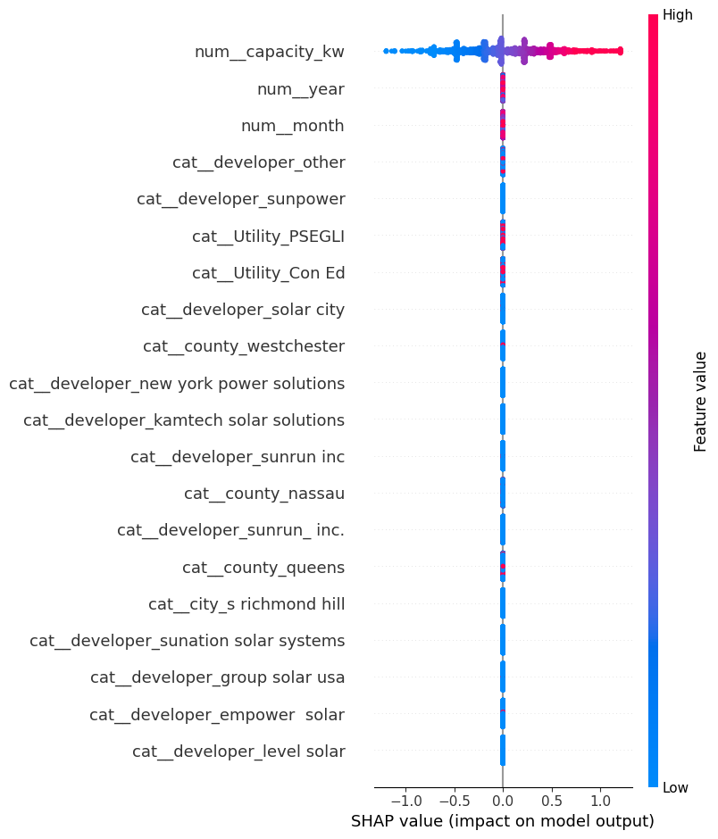
SHAP Feature Importance
The SHAP summary plot shows the impact of each feature on the model’s predictions.
capacity_kw is the most influential feature, with a strong impact on the model output. Higher capacity values (red) push predictions higher, while lower values (blue) reduce predictions.
Other features such as year and month have relatively minor influence.
Most categorical features (developer, utility, county, city) show very low impact, with SHAP values close to zero.
The model relies heavily on system capacity to make predictions.
Temporal and categorical features contribute very little compared to capacity.
This aligns with earlier analysis showing a strong linear relationship between capacity and energy.
SHAP analysis confirms that system capacity is the dominant factor in predicting solar energy output, while other features have minimal influence on the model.

Slide 42
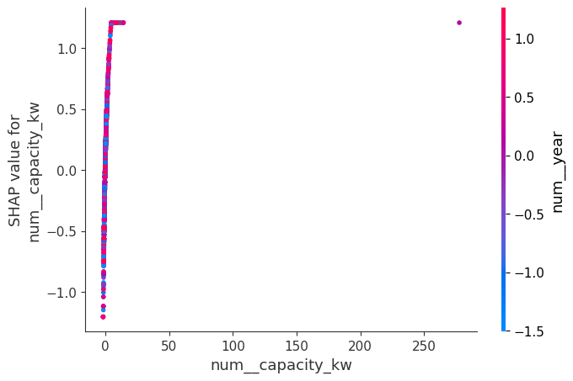
SHAP Dependence Plot – Capacity vs Impact
The plot shows how capacity_kw influences the model’s prediction (SHAP value), with color representing the year.
There is a strong positive relationship between capacity and SHAP values.
As capacity increases, the SHAP value increases, meaning higher capacity leads to higher predicted energy.
Most data points are concentrated at lower capacity values, with a few high-capacity outliers showing strong positive impact.
The color (year) shows minimal variation, indicating that year has little interaction with capacity.
Capacity is the dominant driver of model predictions.
The relationship is almost linear, reinforcing earlier findings from correlation and scatter plots.
Temporal influence (year) does not significantly change the effect of capacity.
The SHAP dependence plot confirms that increasing system capacity directly increases predicted energy output, with minimal influence from temporal factors.

Slide 43
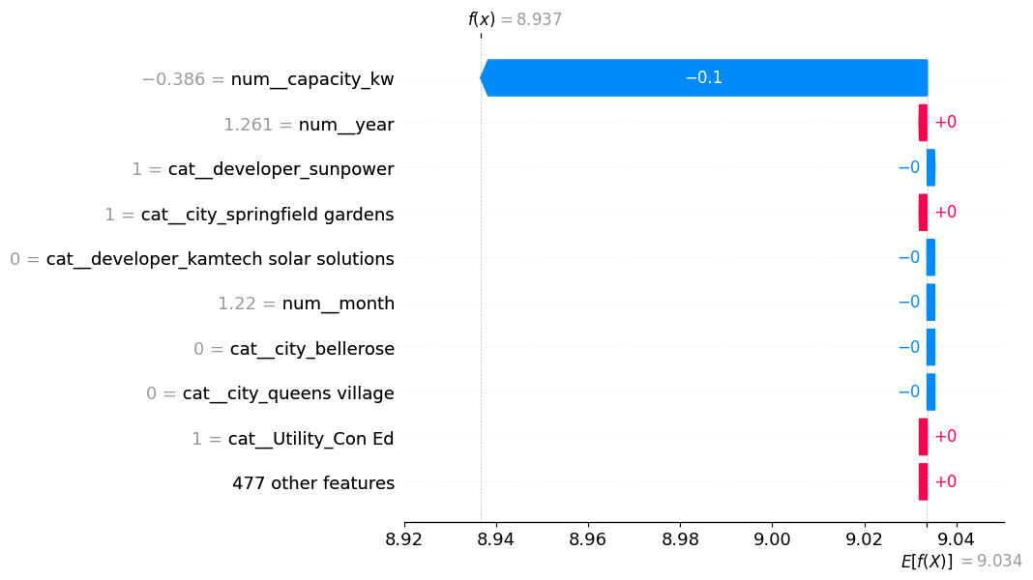
SHAP Explanation (Single Prediction) – Interpretation
This SHAP waterfall plot explains how individual features contribute to a single prediction.
The model’s base value (average prediction) starts around 9.034, and the final prediction is 8.937.
The largest impact comes from capacity_kw, which significantly reduces the prediction (negative contribution).
Other features such as year, month, developer, city, and utility have minimal impact, contributing very small positive or negative values.
Most features collectively have negligible influence, as shown by “477 other features”.
The prediction is primarily driven by system capacity, with other features having minimal impact, confirming that capacity is the key determinant of solar energy output

Slide 44
Final Conclusions – Solar Energy Prediction Project
This project successfully developed a machine learning model to predict solar energy generation, with the tuned Random Forest model achieving extremely high accuracy on the dataset.
Key Findings
1. Capacity is the Dominant Factor
System capacity (capacity_kw) is the most influential feature across all analyses
Strong linear relationship with energy production
SHAP analysis confirmed it drives the majority of predictions
2. Efficiency is Highly Consistent
Energy per kW showed very low variation across systems
Indicates standardized performance across installations
Efficiency differences do not significantly impact predictions

Slide 45
3. Limited Impact of Categorical Features
Developer, utility, city, and county have minimal influence
High cardinality features were simplified without loss of performance
Model relies less on categorical variables
4. Temporal Features Have Minor Influence
Year and month show some seasonal trends, but limited predictive power
Solar production remains relatively stable over time
5. Model Performance
Random Forest (tuned) achieved:
Very low MAE (~0.00001)
R² ≈ 0.9999999
Ensemble models significantly outperformed linear models
The near-perfect performance suggests:
Either very strong feature relationships (especially capacity)
Or potential data leakage / overly deterministic data

Slide 46
Final Takeaways & Business Insight
Solar energy prediction in this dataset is largely deterministic and capacity-driven
Advanced models add value, but feature engineering and data understanding were key
Simpler models could still perform well due to strong feature relationships
Energy output can be reliably estimated using system size alone
Developer or location plays a secondary role
Useful for Capacity planning, ROI estimation & Solar installation optimization
Solar energy generation is primarily driven by system capacity, and a tuned Random Forest model achieved near-perfect prediction accuracy, highlighting strong underlying data relationships

Slide 47
Future Recommendations
Add Real-World Weather Data like Solar irradiance, Temperature, Cloud cover, Humidity & Wind speed
Convert to Time-Series Forecasting- Predict future energy based on past patterns
Improve Feature Engineering : Current features are basic
Reduce Model Overconfidence: Noise robustness checks, Cross-region validation, rop dominant feature (capacity) temporarily to test model
Monitoring & Drift Detection: Data drift detection, Model performance tracking & Retraining pipeline
Move from a capacity-driven model to a weather-aware, time-series forecasting system for real-world solar energy prediction.

